Slide 1


VIDEO LESSON: NETWORKING

Slide 2
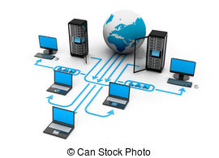
COMPUTER NETWORKING
NETWORK = number of computers linked together and able to share resources, software, data and even a connection to the internet.
- One more powerful computer (SERVER) is in control of the network and is used to store the data and programs needed by the whole network.
- The network is totally dependent on the server; if it breaks down the network cannot be used.
- They are the popular choice for networks that need many computers.
- All the computers have equal status.
- All the computers can share each other’s resources.
- They are only suitable for small networks.
- Only very basic knowledge is needed to set up and use one.
- The more people use the network the slower the network is.
PEER-TO-PEER
CLIENT-SERVER
In order to connect to the network, a computer must be equipped with a NIC. Other network components include: HUB, ROUTER, SWITCH, BRIDGE, REPEATER and GATEWAY.
Medium through which the signals travel from one computer to another: metal wires, fibre optic cables, or wireless connection.

Slide 3

Match each component with its function.
NIC HUB ROUTER SWITCH BRIDGE REPEATER GATEWAY
1. To connect channels together and divide a network into separate segments. Switch
2. To connect two different networks. Router
3. To connect several cables to single output. Hub
4. To direct signals to the correct destination. Gateway
5. To improve the quality of degraded signals. Repeater
6. To inspect incoming traffic. Nic
7. To provide the connection between the computer and the network cables. Bridge

Slide 4

Esercizio 2
Listen to this extract and complete the table below.
PROS OF NETWORKS
CONS OF NETWORKS
Printers and scanners can be
Shared amog the different computers.
Hardware easy to install and mantain.
Users can have access to a central
store of data.
Data cross the network quickly
Security is improved with the use of
Passwords
Communication on the software is cheaper
Than buying strumentation for each computer
Cable and servers can be expensive
To be buyed ad installed
An error of the serrver can prevent all the
Network from working
A network manager is needed and could
Be expensive
Networks are vulnerable to heackers and viruses

Slide 5
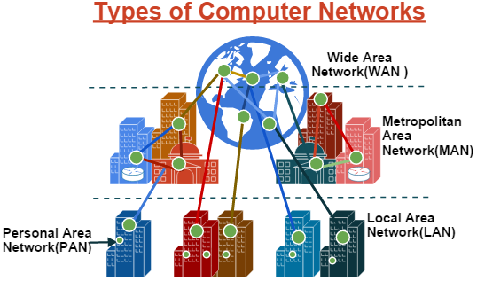
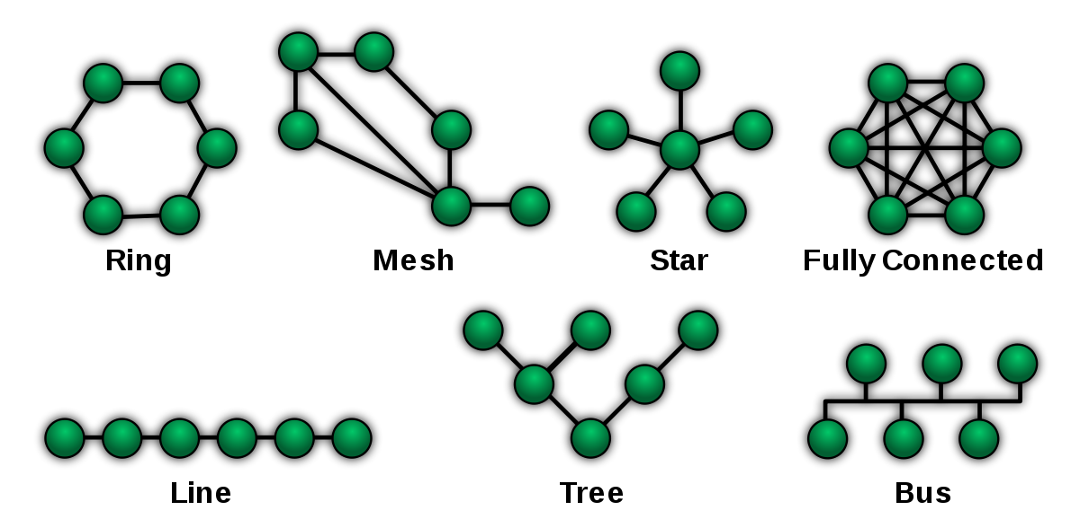
TYPES OF NETWORKS
Apart from the basic distinction between peer-to-peer and client server, computer networks can be also classified according to:
SIZE
TOPOLOGY
LAN
WAN
MAN
...
BUS
RING
STAR
TREE
MESH
LINE

Slide 6
Match each description with the appriopriate network topology.
1. All devices are connected to a main central node or server. The other nodes are connected to it and to each other through a switch or a hub. LAN
2. All devices are connected to a central cable, called the bus or back bone. There are more than two endpoints which are created by adding branches to the main section. If data are being sent between nodes, the others cannot transmit. Bus
3. All devices are connected to one another in the shape of a ring. Each device is connected directly to two other devices, one on either side of it. Data travel in one direction using a control signal called token. Ring
4. All the nodes of the network are connected to a common transmission mediums with exactly two endpoints. The data transmitted is received simultaneously by all the nodes in the network.Star
5. There is a direct link between all pairs of nodes. There are multiple paths for data provided by a large number of redundant links between nodes. Fully connected
6. There are redundant interconnections between network nodes. Every node has a connection to any other node in the network. Mesh
7. A hybrid type in which groups of star networks are connected to a linear backbone, like in a afmily tree. Tree

Slide 7
Read the texts pp. 104-105 and fill in the table below.
TOPOLOGY
ADVANTEGES
DISADVANTAGES
Bus
Actually cheap
It doesn’t require much cable
The possible collision in the
network can slow it down
Every workstation sees all
of the data on the network
Ring
Quite fast
If a device fails the entire
network fails
Large use of the cable
Star
No redundant cable
Very efficent in the
trasmisssion of data
Very expensive to expand
Tree
Very expandible
Fault tolerant
Easy to troubleshoot
Very expensive

Slide 8

HOW AN ETHERNET WORKS
Student's book p. 106 (text 3), 107 n. 6,7
Student's book p. 104 (text 1), 105 (text 2)

